Slide 1
Polynomial Regression Using Scikit Learn

Slide 2
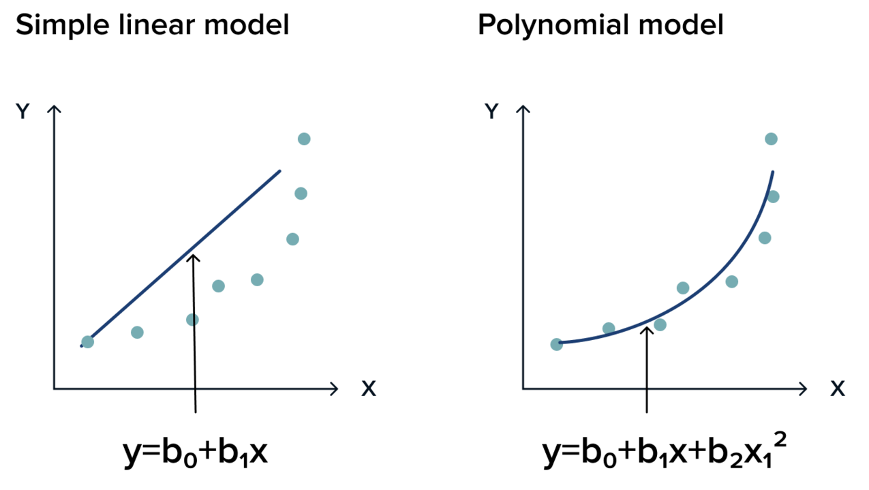
What is Polynomial Regression?
Multiple linear regression models that work together when data to be modeled is not linear
Effectively produces a line of best fit
Machine learning is used to determine the function that defines the polynomial regression

Slide 3
Polynomial Regression
Advantages
Disadvantages
Flexible for a wide range of data
Many different functions can be produced using this algorithm
Best approximation between two dependent and independent variables
Outliers can have a significant impact on the overall accuracy of the approximation
It is also difficult to filter for outliers and get rid of them such that the approximation is more accurate

Slide 4
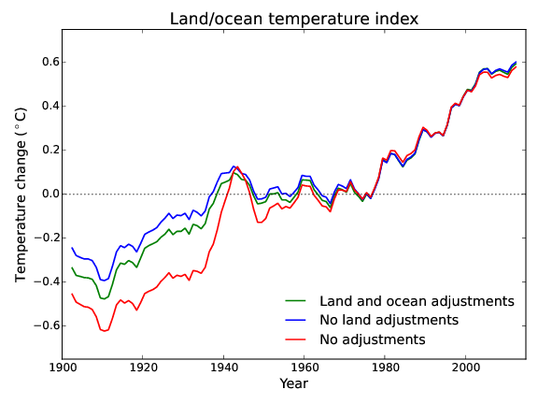
Application: Temperature Data
Polynomial regression will be used to find overall temperature trends each day over any time period
Uses Scikit Learn and Python libraries
Temperature data can be collected, found on the internet, or generated for easy use

Slide 5
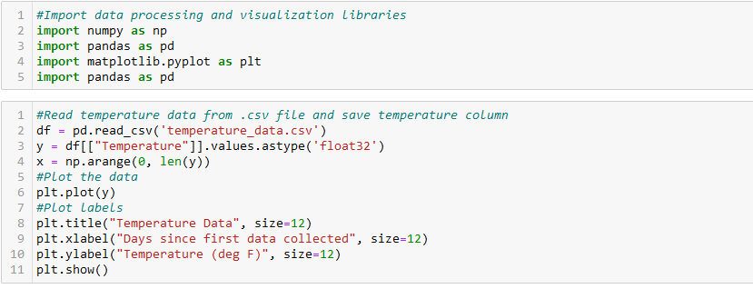
Code- Polynomial_Regression_Template

Slide 6
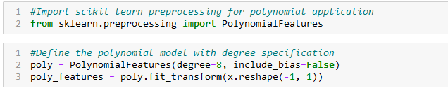
Code- Polynomial_Regression_Template

Slide 7
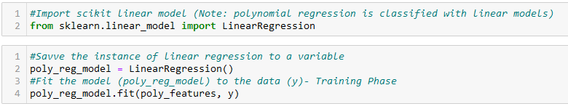
Code- Polynomial_Regression_Template

Slide 8
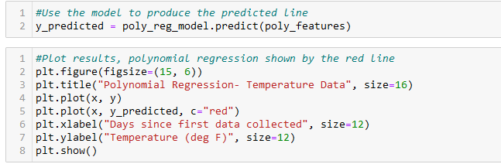
Code- Polynomial_Regression_Template

